Slide 1
Lecture 21
Data Compression

Slide 2
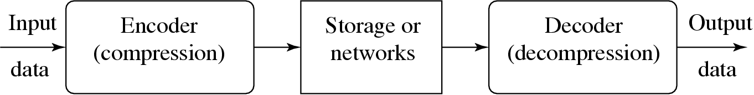
Data Compression
Branch of information theory
minimize amount of information to be transmitted
Transform a sequence of characters into a new string of bits
same information content
length as short as possible
Notes:
ORCHID Research Group
Department of Computer Science, University of Illinois at Urbana-Champaign
‹#›

Slide 3
Data Compression
Why Compression?
All media, be it text, audio, graphics or video has “redundancy”.
Compression attempts to eliminate this redundancy.
What is Redundancy?
If one representation of a media content, M, takes X bytes and another takes Y bytes(Y< X), then X is a redundant representation relative to Y.
Other forms of Redundancy
If the representation of a media captures content that is not perceivable by humans, then removing such content will not affect the quality of the content.
For example, capturing audio frequencies outside the human hearing range can be avoided without any harm to the audio’s quality.
Notes:
ORCHID Research Group
Department of Computer Science, University of Illinois at Urbana-Champaign
‹#›

Slide 4
Data Compression
Lossless Compression
Compression with loss
M
M
Lossless Compress
Compress with loss
m
m
M’ ≈ M
Uncompress
Uncompress
M
M’
Notes:
‹#›
Before we look at Information theory lets make a clear distinction between lossless compression and compression with loss, or sometimes referred to as lossy compression.
Notice from the two figures:
When lossless compression is used the compressed media, M, does not loose any content, therefore, uncompressing it restores the media to its native state, M.
On the other hand with a lossy compression, the compressed media when uncompressed is different from the original media. Depending on the mechanism used the difference might be too subtle to notice.

Slide 5
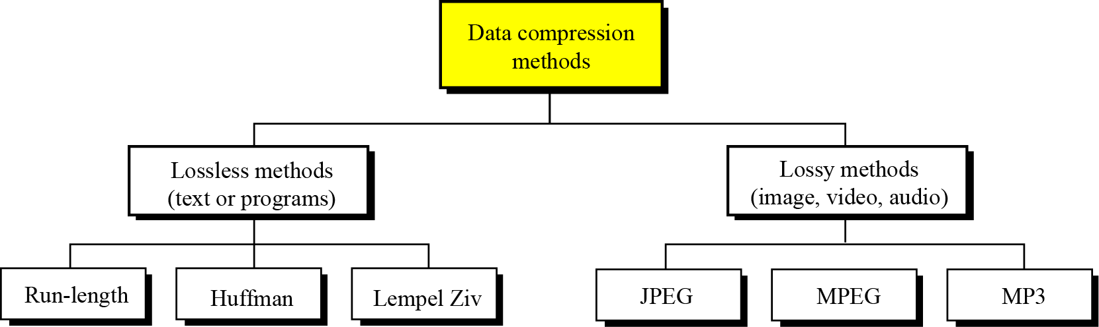
Data Compression
Data compression implies sending or storing a smaller number of bits.
Divided into two broad categories: lossless and lossy methods
Notes:
ORCHID Research Group
Department of Computer Science, University of Illinois at Urbana-Champaign
‹#›

Slide 6
Concepts
Coding (the code) maps source messages from alphabet (A) into code words (B)
Source message (symbol) is basic unit into which a string is partitioned
can be a single letter or a string of letters
EXAMPLE: aa bbb cccc ddddd eeeeee fffffffgggggggg
A = {a, b, c, d, e, f, g, space}
B = {0, 1}
Notes:
ORCHID Research Group
Department of Computer Science, University of Illinois at Urbana-Champaign
‹#›

Slide 7
Taxonomy of Codes
Block-block
source msgs and code words of fixed length; e.g., ASCII
Block-variable
source message fixed, code words variable; e.g., Huffman coding
Variable-block
source variable, code word fixed; e.g., RLE, LZW
Variable-variable
source variable, code words variable; e.g., Arithmetic
Notes:
ORCHID Research Group
Department of Computer Science, University of Illinois at Urbana-Champaign
‹#›

Slide 8
Example of Block-Block
Coding “aa bbb cccc ddddd eeeeee fffffffgggggggg”
Requires 120 bits
Symbol | Code word
a | 000
b | 001
c | 010
d | 011
e | 100
f | 101
g | 110
space | 111
Notes:
ORCHID Research Group
Department of Computer Science, University of Illinois at Urbana-Champaign
‹#›

Slide 9
Example of Variable-Variable
Coding “aa bbb cccc ddddd eeeeee fffffffgggggggg”
Requires 30 bits
don’t forget the spaces
Symbol | Code word
aa | 0
bbb | 1
cccc | 10
ddddd | 11
eeeeee | 100
fffffff | 101
gggggggg | 110
space | 111
Notes:
ORCHID Research Group
Department of Computer Science, University of Illinois at Urbana-Champaign
‹#›

Slide 10
Concepts (cont.)
A code is
distinct if each code word can be distinguished from every other (mapping is one-to-one)
uniquely decodable if every code word is identifiable when immersed in a sequence of code words
e.g., with previous table, message 11 could be defined as either ddddd or bbbbbb
Notes:
ORCHID Research Group
Department of Computer Science, University of Illinois at Urbana-Champaign
‹#›

Slide 11
Measure of Information
Consider symbols s_{i} and the probability of occurrence of each symbol p(s_{i})
In case of fixed-length coding , smallest number of bits per symbol needed is
L ≥ log₂(N) bits per symbol
Example: Message with 5 symbols need 3 bits (L ≥ log₂5)
Notes:
ORCHID Research Group
Department of Computer Science, University of Illinois at Urbana-Champaign
‹#›

Slide 12
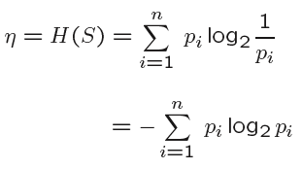
Variable-Length Coding- Entropy
What is the minimum number of bits per symbol?
Answer: Shannon’s result – theoretical minimum average number of bits per code word is known as Entropy (H)
Notes:
ORCHID Research Group
Department of Computer Science, University of Illinois at Urbana-Champaign
‹#›

Slide 13
Entropy Example
Alphabet = {A, B}
p(A) = 0.4; p(B) = 0.6
Compute Entropy (H)
-0.4*log₂ 0.4 + -0.6*log₂ 0.6 = .97 bits
Notes:
ORCHID Research Group
Department of Computer Science, University of Illinois at Urbana-Champaign
‹#›

Slide 14
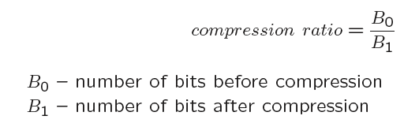
Compression Ratio
Compare the average message length and the average codeword length
e.g., average L(message) / average L(codeword)
Example:
{aa, bbb, cccc, ddddd, eeeeee, fffffff, gggggggg}
Average message length is 5
If we use code-words from slide 9, then
We have {0,1,10,11,100,101,110}
Average codeword length is 2.14.. Bits
Compression ratio: 5/2.14 = 2.336
Notes:
ORCHID Research Group
Department of Computer Science, University of Illinois at Urbana-Champaign
‹#›

Slide 15
Entropy Coding Algorithms (Content Dependent Coding)
Run-length Encoding (RLE)
Replaces sequence of the same consecutive bytes with number of occurrences
Number of occurrences is indicated by a special flag (e.g., !)
Example:
abcccccccccdeffffggg (20 Bytes)
abc!9def!4ggg (13 bytes)
Notes:
‹#›

Slide 16
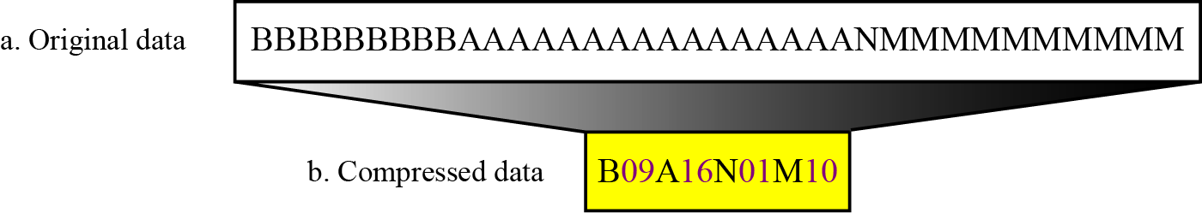
Example
Notes:
‹#›

Slide 17
Huffman Encoding
Statistical encoding
To determine Huffman code, it is useful to construct a binary tree
Leaves are characters to be encoded
Nodes carry occurrence probabilities of the characters belonging to the subtree
Notes:
Depends on occurrence frequency of single characters or sequences of data bytes
Characters are stored with their probabilities
Length (number of bits) of the coded characters differs
The shortest code is assigned to the most frequently occurred character
‹#›

Slide 18
The Huffman Algorithm
Example
Initialization: Put all nodes in an OPEN list L, keep it sorted at all times (e.g., ABCDE).
Repeat the following steps until the list L has only one node left:
From L pick two nodes having the lowest frequencies, create a parent node of them.
Assign the sum of the children's frequencies to the parent node and insert it into L.
Assign code 0, 1 to the two branches of the tree, and delete the children from L.
1
0
39
0
1
24
0
1
0
1
13
11
Count
15
7
6
6
5
Symbol
A
B
C
D
E
Symbol | Count | Info. -log₂(p_{i}) | Code | Subtotal# of Bits
A | 15 | 1.38 | 1 | 15
B | 7 | 2.48 | 000 | 21
C | 6 | 2.70 | 001 | 18
D | 6 | 2.70 | 010 | 18
E | 5 | 2.96 | 011 | 15
x
x
x
x
x
85.25
87
Notes:
‹#›
Screen1: Lets take the same example. We compute the frequencies and sort the symbols in a list by decreasing order of frequencies. We maintain this list in sorted order at all times. Each symbol is represented by a node.
Screen2: Take the lowest two nodes and add up their frequencies, create a parent node from them whose frequency is the sum of their frequencies. Insert this node into the list. This insertion will be in sorted order. Therefore the list will now contain: A new_node B and C. Assign codes 0 and 1 to the left and right branches of the tree and delete the two children (D and E) from the list.
Screen3,4,5: Repeat the process by picking the lowest frequency nodes from the list, till you are left with only one node in the list.
Screen 6,7: Lets do a little analysis. Again the table shows the entropy of each symbol (same as before) along with the codes assigned by the Huffman Coding. We also compute the contribution in bits of each symbol.. We note that it takes a total of 87 bits using the Huffman Algorithm to encode 85.25 bits of information.
This might not seem like a significant improvement from Shannon-Fano’s coding but it turns out to be optimal in that there is NO code assignment that can reduce the # of bits needed to less than 87.

Slide 19
Huffman Encoding
Example: How does a Huffman code look like for symbols with statistical symbol occurrence probabilities:
P(A) = 8/20, P(B) = 3/20, P(C ) = 7/20, P(D) = 2/20?
Notes:
Depends on occurrence frequency of single characters or sequences of data bytes
Characters are stored with their probabilities
Length (number of bits) of the coded characters differs
The shortest code is assigned to the most frequently occurred character
‹#›

Slide 20
Huffman Encoding (Example)
Step 1 : Sort all Symbols according to their probabilities
(left to right) from Smallest to largest
these are the leaves of the Huffman tree
P(B) = 0.51
P(C) = 0.09
P(E) = 0.11
P(D) = 0.13
P(A)=0.16
Notes:
‹#›

Slide 21
Huffman Encoding (Example)
Step 2: Build a binary tree from left to
Right
Policy: always connect two smaller nodes
together (e.g., P(CE) and P(DA) had both
Probabilities that were smaller than P(B),
Hence those two did connect first
P(CEDAB) = 1
P(CEDA) = 0.49
P(B) = 0.51
P(CE) = 0.20
P(DA) = 0.29
P(C) = 0.09
P(E) = 0.11
P(D) = 0.13
P(A)=0.16
Notes:
‹#›

Slide 22
Huffman Encoding (Example)
Step 3: label left branches of the tree
With 0 and right branches of the tree
With 1
P(CEDAB) = 1
0
1
P(CEDA) = 0.49
P(B) = 0.51
0
1
P(CE) = 0.20
P(DA) = 0.29
0
1
0
1
P(C) = 0.09
P(E) = 0.11
P(D) = 0.13
P(A)=0.16
Notes:
‹#›

Slide 23
Huffman Encoding (Example)
Step 4: Create Huffman Code
Symbol A = 011
Symbol B = 1
Symbol C = 000
Symbol D = 010
Symbol E = 001
P(CEDAB) = 1
0
1
P(CEDA) = 0.49
P(B) = 0.51
0
1
P(CE) = 0.20
P(DA) = 0.29
0
1
0
1
P(C) = 0.09
P(E) = 0.11
P(D) = 0.13
P(A)=0.16
Notes:
‹#›

Slide 24
END

